Slide 1
News Topic classification
Supervised machine learning : Text Classification algorithm
Girish Vankudre

Slide 2
Problem statement
From the beginning, since the first printed newspaper, every news that makes into a page has had a specific section allotted to it. Although pretty much everything changed in newspapers from the ink to the type of paper used, this proper categorization of news was carried over by generations and even to the digital versions of the newspaper.
Newspaper articles are not limited to a few topics or subjects, it covers a wide range of interests from politics to sports to movies and so on. For long, this process of sectioning was done manually by people but now technology can do it without much effort.
In this problem statement, requirement is to use Natural Language Processing to predict and classify which genre or category a piece of news will fall in to from the story.
There are four distinct sections where each story may fall in to. The Sections are labelled as follows : Politics: 0, Technology: 1, Entertainment: 2, Business: 3

Slide 3

Dataset and Data dictionary (List of features available for analysis and prediction)
STORY: A part of the main content of the article to be published as a piece of news.
SECTION: The genre/category the STORY falls in. There are four distinct sections where each story may fall in to. The Sections are labelled as follows : Politics: 0 Technology: 1 Entertainment: 2 Business: 3

Slide 4
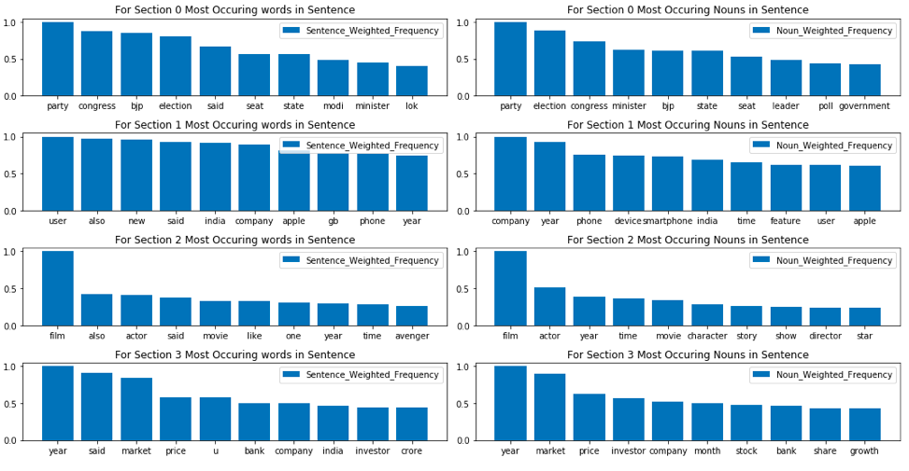
Exploratory Data Analysis
Using basic text scrubbing techniques and Lemmatization method, we are able to deduce key words (along with their part of speech) and plot it as a graph of Most Occurring Words & Nouns in each section.

Slide 5
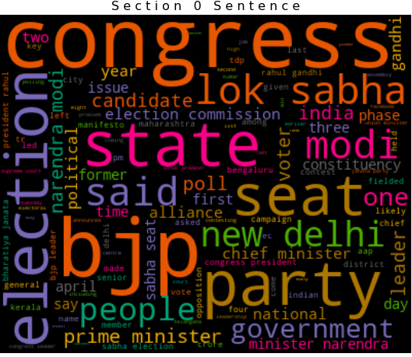
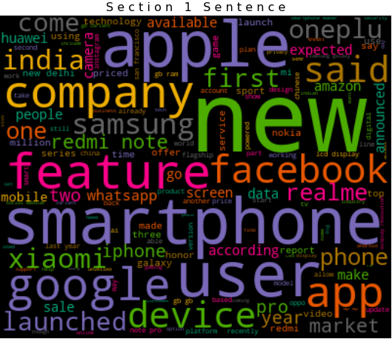
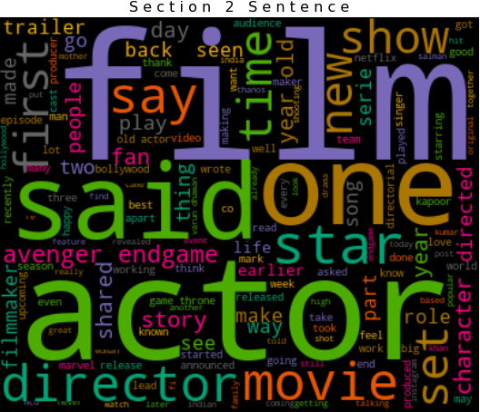

Exploratory Data Analysis – Wordcloud

Slide 6
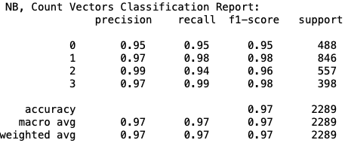
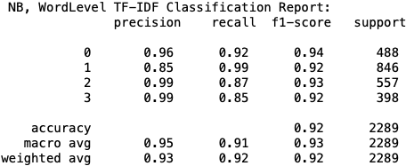
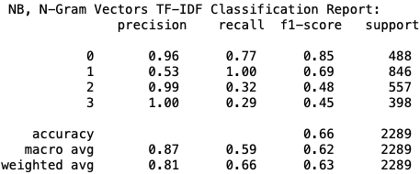
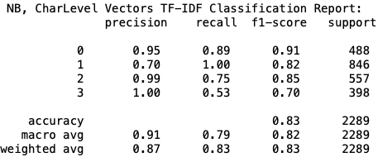
model evaluation – Training Data – Naive BAYES
NB with Count Vector Feature NB with TFIDF Word Vector Feature
NB with TFIDF Ngram Vector Feature NB with TFIDF Ngram Char Vector Feature

Slide 7
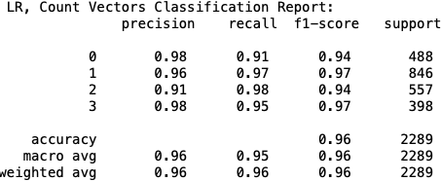

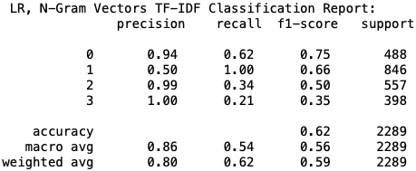
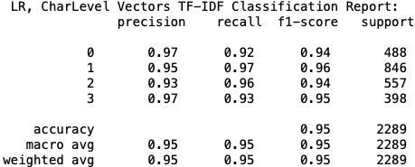
model evaluation – Training Data – Logistic Regression
LR with Count Vector Feature LR with TFIDF Word Vector Feature
LR with TFIDF Ngram Vector Feature LR with TFIDF Ngram Char Vector Feature

Slide 8


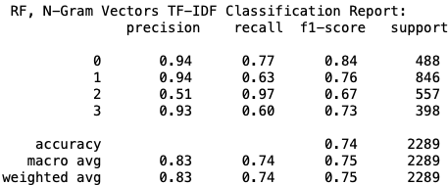
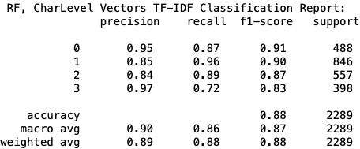
model evaluation – Training Data – Random Forest
RF with Count Vector Feature RF with TFIDF Word Vector Feature
RF with TFIDF Ngram Vector Feature RF with TFIDF Ngram Char Vector Feature

Slide 9


model evaluation – Test Data - machinehack
When we ran all the models on Test Data, we got best result so far with Logistic Regression with Word Level TFIDF Vectorizer as a feature. The evaluation matrix used is standard accuracy_score metric from sklearn.
When we further hypertuned Logistic Regression Model with GridSearchCV and Word Level TFIDF Vectorizer as a feature, we see a slight improvement in the accuracy score.

